Slide 1
The Gospel of John
Bringing Jesus Into Focus

Slide 2
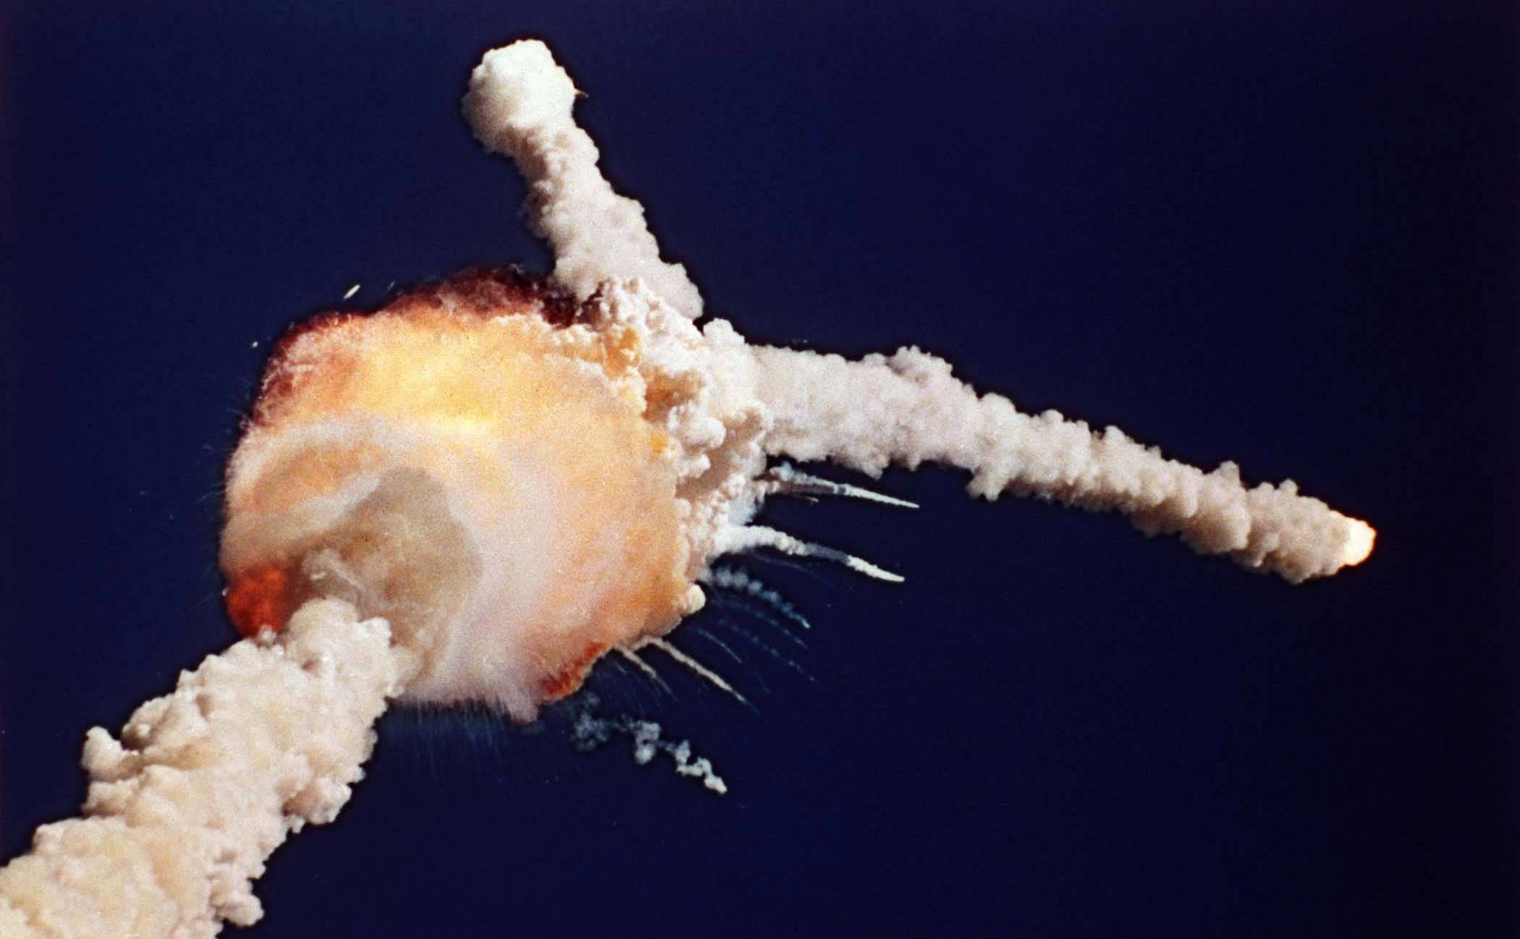

Slide 3
John 8:56-58
⁵⁶ Your father Abraham rejoiced at the thought of seeing my day; he saw it and was glad.”
⁵⁷ “You are not yet fifty years old,” they said to him, “and you have seen Abraham!”
⁵⁸ “Very truly I tell you,” Jesus answered, “before Abraham was born, I am!”

Slide 4
John 8:12
¹² When Jesus spoke again to the people, he said, “I am the light of the world. Whoever follows me will never walk in darkness, but will have the light of life.”

Slide 5
John 8:17-18
¹⁷ In your own Law it is written that the testimony of two witnesses is true. ¹⁸ I am one who testifies for myself; my other witness is the Father, who sent me.”

Slide 6
John 8:23-24
²³ But he continued, “You are from below; I am from above. You are of this world; I am not of this world. ²⁴ I told you that you would die in your sins; if you do not believe that I am he, you will indeed die in your sins.”

Slide 7
John 8:31-32
³¹ To the Jews who had believed him, Jesus said, “If you hold to my teaching, you are really my disciples. ³² Then you will know the truth, and the truth will set you free.”

Slide 9
The Gospel of John
Bringing Jesus Into Focus

